Slide 1


Deep Unsupervised Learning
Naeemullah Khan
naeemullah.khan@kaust.edu.sa
KAUST Academy
King Abdullah University of Science and Technology

Slide 2
Anomaly/Outlier Detection
What are anomalies/outliers?
The set of data points that are considerably different than the remainder of the data
Variants of Anomaly/Outlier Detection Problems
Given a database D, find all the data points x ∈ D with anomaly scores greater than some threshold t
Given a database D, find all the data points x ∈ D having the top-n largest anomaly scores f(x)
Given a database D, containing mostly normal (but unlabeled) data points, and a test point x, compute the anomaly score of x with respect to D
Applications:
Credit card fraud detection, telecommunication fraud detection, network intrusion detection, fault detection

Slide 3
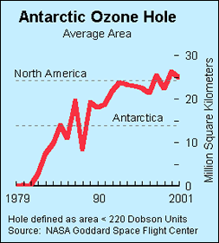
Importance of Anomaly Detection
Ozone Depletion History
In 1985 three researchers (Farman, Gardinar and Shanklin) were puzzled by data gathered by the British Antarctic Survey showing that ozone levels for Antarctica had dropped 10% below normal levels
Why did the Nimbus 7 satellite, which had instruments aboard for recording ozone levels, not record similarly low ozone concentrations?
The ozone concentrations recorded by the satellite were so low they were being treated as outliers by a computer program and discarded!
Sources:http://en.wikipedia.org/wiki/Ozone_depletion

Slide 4
Anomaly Detection
Challenges
How many outliers are there in the data?
Method is unsupervised
Validation can be quite challenging (just like for clustering)
Finding needle in a haystack
Working assumption:
There are considerably more “normal” observations than “abnormal” observations (outliers/anomalies) in the data

Slide 5
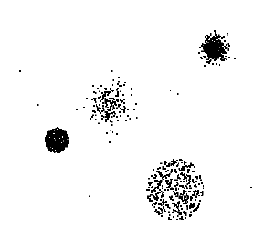
Anomaly Detection Schemes
General Steps
Build a profile of the “normal” behavior
Profile can be patterns or summary statistics for the overall population
Use the “normal” profile to detect anomalies
Anomalies are observations whose characteristics differ significantly from the normal profile
Types of anomaly detection schemes
Graphical
Model-based
Distance-based
Clustering-based

Slide 6
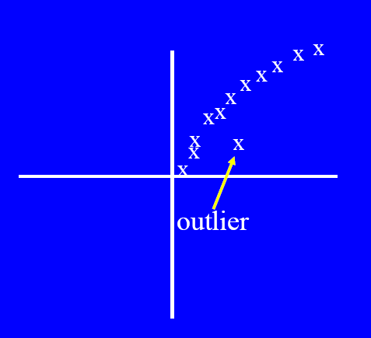
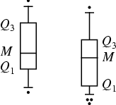
Graphical Approaches
Boxplot (1-D), Scatter plot (2-D), Spin plot (3-D)
Limitations
Time consuming
Subjective
e.g.: data are outliers if the more than 1.5 IQR (or 3 IQR) away from the box!

Slide 7
R Box Plots
R Box Plots
Invented by J. Tukey
Another way of displaying the distribution of data
Following figure shows the basic part of a box plot
outlier
Maximum (or at most 1.5 IQR off the 75th percentile)
75th percentile
IQR
50th percentile
25th percentile
Minimum (or at most 1.5 IQR off the 25th percentile)

Slide 8
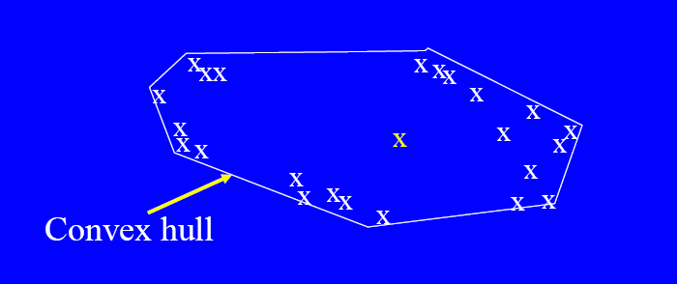
Convex Hull Method
Extreme points are assumed to be outliers
Use convex hull method to detect extreme values
http://www2.cs.uh.edu/~ceick/kdd/AEC13.pdf
Approach: Fit a polygon to a point set; outliers are determined by their distance to the polygon boundary

Slide 9
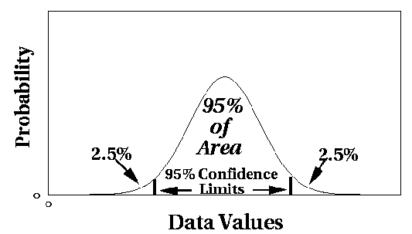
Statistical Approaches---Model-based
Fit a parametric model M describing the distribution of the data (e.g., normal distribution) http://en.wikipedia.org/wiki/Distribution_fitting http://en.wikipedia.org/wiki/Maximum_likelihood
Assess the probability of each point M
The lower a point’s probability the more likely the point is an outlier.
Outlier Detection Approach:
Sort points by the probability
Determine Outliers
based on a probability threshold
take the bottom x percent as outliers.

Slide 10
Limitations of Statistical Approaches
Many methods have been designed for a single attribute and are not easy to generalize to multi-dimensional data
In many cases, data distribution/model may not be known, and might not match the assumoptions of the employed density function (e.g. not symmetric, not Gaussian,…)
For high dimensional data, it may be difficult to estimate the true distribution, but there is new work based on EM and mixtures of Gaussians

Slide 11
Distance-based Approaches
Data is represented as a vector of features
Three major approaches
Nearest-neighbor based
Density based
Clustering based

Slide 12
Nearest-Neighbor Based Approach
Approach:
Compute the distance between every pair of data points
There are various ways to define outliers:
Data points for which there are fewer than p neighboring points within a distance D
The top n data points whose distance to the kth nearest neighbor is greatest
The top n data points whose average distance to the k nearest neighbors is greatest

Slide 13
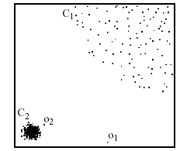
Density-based: LOF approach
For each point, compute the density of its local neighborhood; e.g. use DBSCAN’s approach
Compute local outlier factor (LOF) of a sample p as the average of the ratios of the density of sample p and the density of its nearest neighbors
Outliers are points with lowest LOF value
In the NN approach, p₂ is not considered as outlier, while LOF approach find both p₁ and p₂ as outliers
p₂
×
Alternative approach: directly use density function; e.g. DENCLUE’s density function
p₁
×

Slide 14
Clustering-Based
Idea: Use a clustering algorithm that has some notion of outliers!
Problem what parameters should I choose for the algorithm; e.g. DBSCAN?
Rule of Thumb: Less than x% of the data should be outliers (with x typically chosen between 0.1 and 10); x might be determined with other methods; e.g. statistical tests or domain knowledge.
Once you have an idea, how much outliers you want, the parameter selection problem becomes easier.

Slide 15
SVM for Anomaly Detection

Slide 16
Linear Separators
If training data is linearly separable, perceptron is guaranteed to find some linear separator
Which of these is optimal?

Slide 17
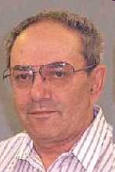
Support Vector Machine (SVM)
SVMs (Vapnik, 1990’s) choose the linear separator with the
largest margin
Robust to outliers!
V. Vapnik
Good according to intuition, theory, practice
SVM became famous when, using images as input, it gave accuracy comparable to neural-network with hand-designed features in a handwriting recognition task

Slide 18
Support vector machines: 3 key ideas
Use optimization to find solution (i.e. a hyperplane) with few errors
Seek large margin separator to improve generalization
Use kernel trick to make large feature spaces computationally efficient

Slide 19













Finding a perfect classifier (when one exists) using linear programming
For every data point (x_{t}, y_{t}), enforce the constraint
for y_{t} = +1, and for y_{t} = -1,
Equivalently, we want to satisfy all of the linear constraints
w.x + b = +1
w.x + b = 0
w.x + b = -1
This linear program can be efficiently solved using algorithms such as simplex, interior point, or ellipsoid

Slide 20
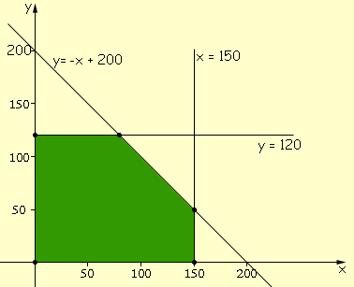






Finding a perfect classifier (when one exists) using linear programming
Weight space
Example of 2-dimensional linear programming (feasibility) problem:
For SVMs, each data point gives one inequality:
What happens if the data set is not linearly separable?

Slide 21
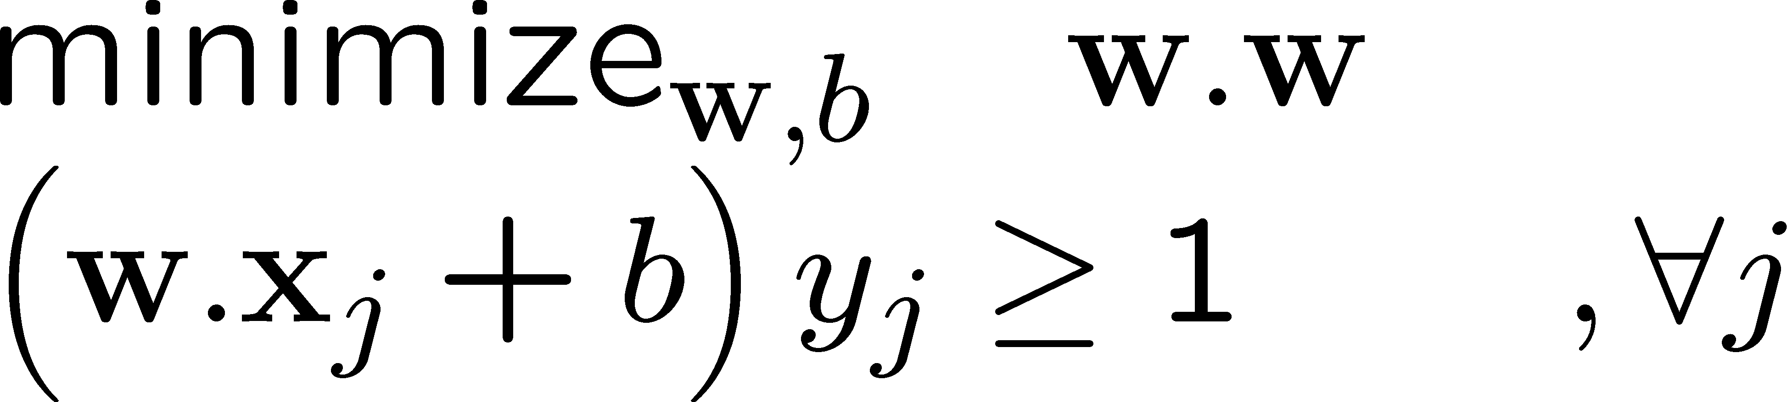
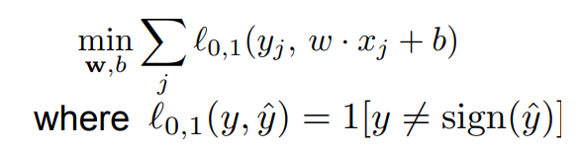
Minimizing number of errors (0-1 loss)
Try to find weights that violate as few constraints as possible?
#(mistakes)
Formalize this using the 0-1 loss:
Unfortunately, minimizing 0-1 loss is NP-hard in the worst-case
– Non-starter. We need another approach.

Slide 22





Key idea #1: Allow for slack
w.x + b = +1
Σ_{j} ξ_{j}
w.x + b = 0
w.x + b = -1
, ξ
- ξ_{j}
ξ_{j}≥0
ξ₁
ξ₂
“slack variables”
ξ₃
We now have a linear program again, and can efficiently find its optimum
ξ₄
For each data point:
If functional margin ≥ 1, don’t care
If functional margin < 1, pay linear penalty

Slide 23






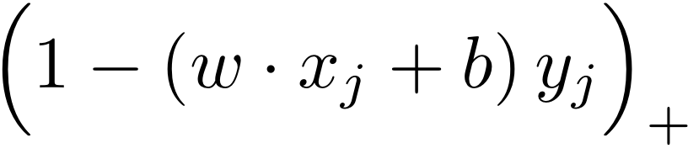



Key idea #1: Allow for slack
w.x + b = +1
Σ_{j} ξ_{j}
w.x + b = 0
w.x + b = -1
, ξ
- ξ_{j}
ξ_{j}≥0
ξ₁
ξ₂
“slack variables”
ξ₃
What is the optimal value ξ * as a function
of w* and b*?
j
ξ₄
If
then ξ_{j} = 0
then ξ_{j} =
If
Sometimes written as

Slide 24
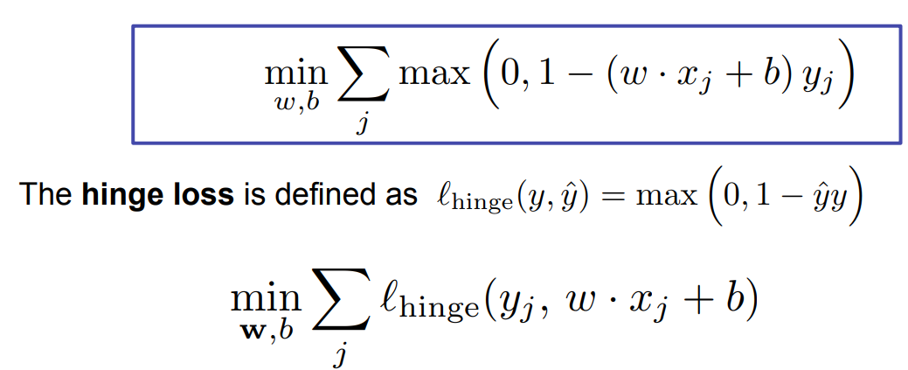
Equivalent hinge loss formulation
Σ_{j} ξ_{j}
, ξ
- ξ_{j}
ξ_{j}≥0
into the objective, we get:
Substituting
This is empirical risk minimization, using the hinge loss

Slide 25



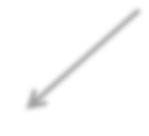





Hinge loss vs. 0/1 loss
Hinge loss:
0-1 Loss:
1
0
1
Hinge loss upper bounds 0/1 loss!
It is the tightest convex upper bound on the 0/1 loss

Slide 26
Key idea #2: seek large margin

Slide 27


Key idea #2: seek large margin
Suppose again that the data is linearly separable and we are solving a feasibility problem, with constraints
If the length of the weight vector ||w|| is too small, the optimization problem is infeasible! Why?
w.x + b = 0
w.x + b = 0
w.x + b = +1
w.x + b = -1
As ||w|| (and |b|) get smaller
w.x + b = +1
w.x + b = -1

Slide 28
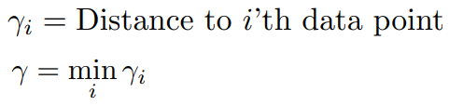



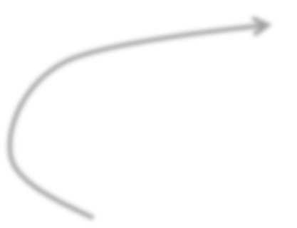
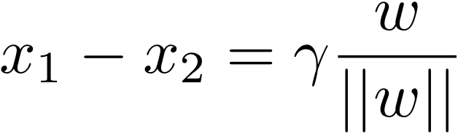

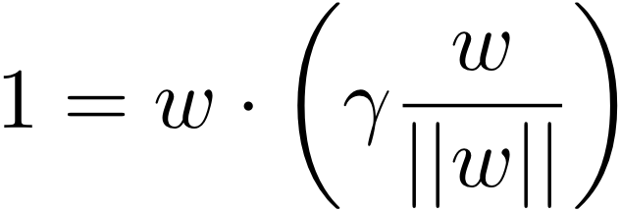
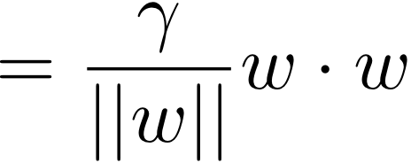

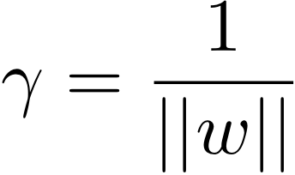

What is (geometric margin) as a function of w?
-
w.x + b = +1
w.x + b = 0
w.x + b = -1
We also know that:
γ
x₁
x₂
So,
(assuming there is a data point on the w.x + b = +1 or -1 line)
Final result: can maximize
by minimizing ||w||₂!!!

Slide 29
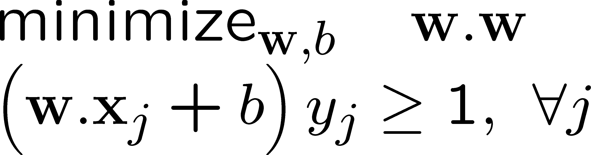





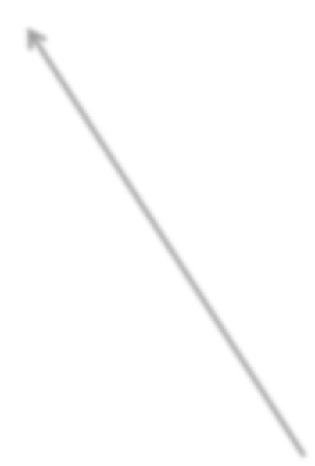
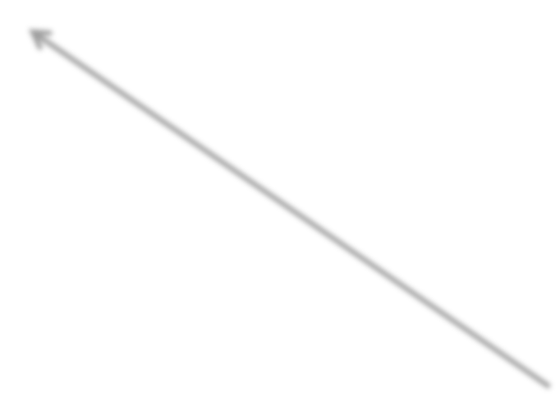


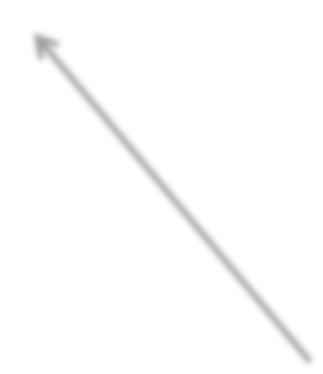
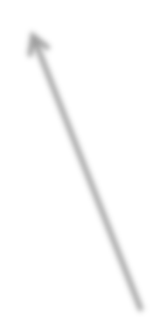

(Hard margin) support vector machines
w.x + b = +1
w.x + b = 0
w.x + b = -1
Example of a convex optimization problem
A quadratic program
Polynomial-time algorithms to solve!
Hyperplane defined by support vectors
Could use them as a lower-dimension basis to write down line, although we haven’t seen how yet
More on these later
margin 2γ
Non-support Vectors:
everything else
moving them will not change w
Support Vectors:
data points on the canonical lines

Slide 30





Allowing for slack: “Soft margin SVM”
+ C Σ_{j} ξ_{j}
- ξ_{j}
w.x + b = +1
w.x + b = 0
w.x + b = -1
ξ_{j}≥0
ξ₁
“slack variables”
ξ₂
Slack penalty C > 0:
C=∞ → have to separate the data!
C=0 → ignores the data entirely!
Select using cross-validation
ξ₃
ξ
4
For each data point:
If margin ≥ 1, don’t care
If margin < 1, pay linear penalty

Slide 31
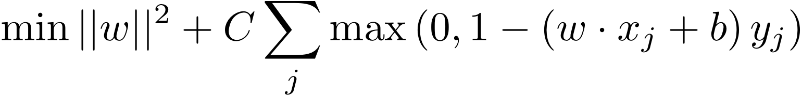
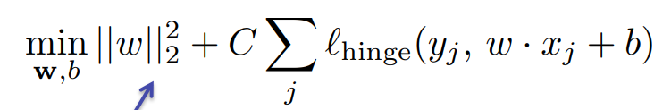

Equivalent formulation using hinge loss
+ C Σ_{j} ξ_{j}
- ξ_{j}
ξ_{j}≥0
Substituting
into the objective, we get:
The hinge loss is defined as
This is called regularization; used to prevent overfitting!
This part is empirical risk minimization, using the hinge loss

Slide 32



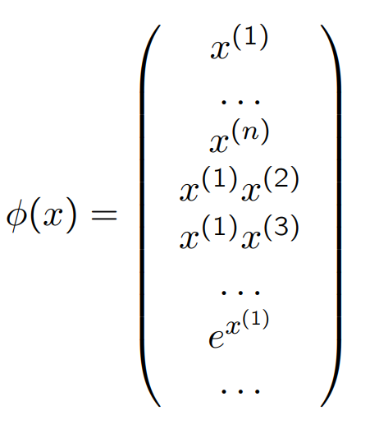









What if the data is not linearly separable?
Use features of features of features of features….
Feature space can get really large really quickly!

Slide 33
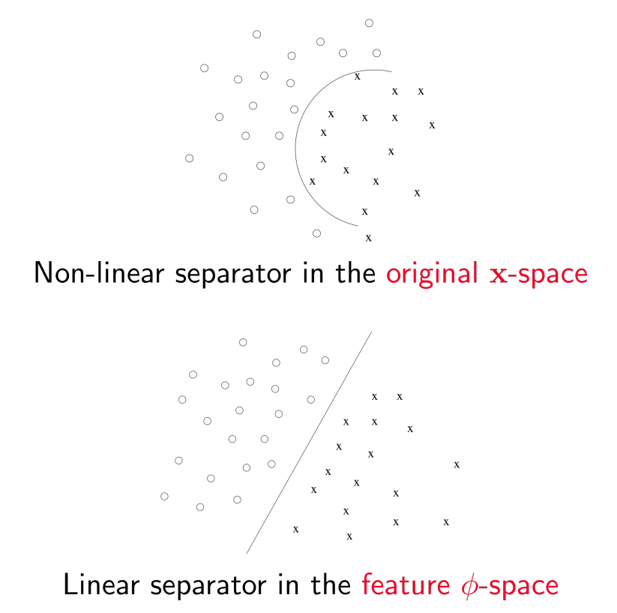
Example

Slide 34
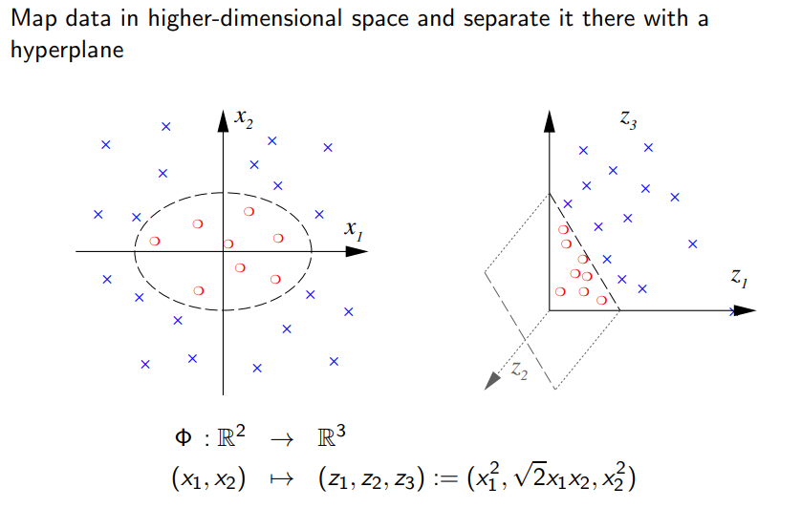
Separate in higher dimension
https://indico.gsi.de/event/10576/contributions/44281/attachments/32809/42150/slides-svm.pdf

Slide 35
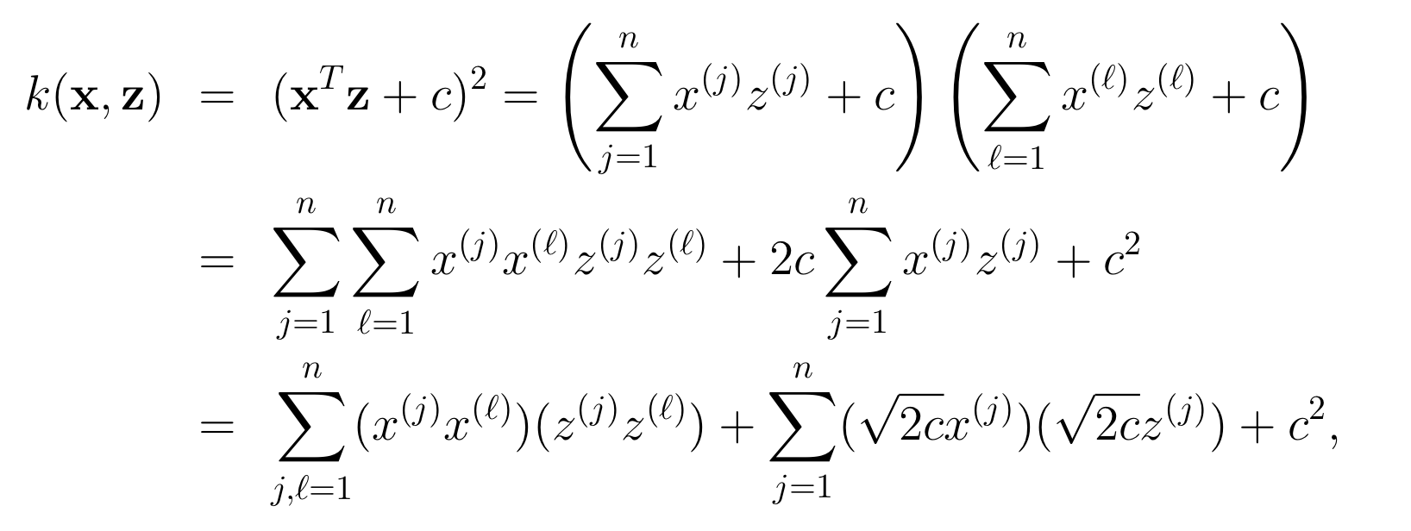
Quadratic kernel
Feature mapping given by:
[Cynthia Rudin]

Slide 36
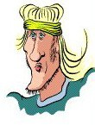










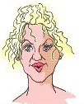


One-Class Classification
Can we learn from examples of just one class, say positive examples? May be desirable if there are many types of negative examples
Positive Examples
Several Types of “Negative” Examples
“Outlier/Novelty Detection” problems can also be formulated like this
Figure credit: Refael Chickvashvili

Slide 37
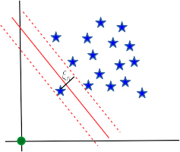
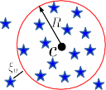
One-Class Classification via SVM-like methods
There are two popular SVM-type approaches to solve one-class problems
Support Vector Data Description (SVDD)
One-Class SVM (OC-SVM)
Origin
Approach 1: Assume positives lie within a ball with smallest possible radius (and allow slacks)
Known as “Support Vector Data Description” (SVDD). Proposed by [Tax and Duin, 2004]
Approach 2: Find a max-marg hyperplane separating positives from origin (representing negatives)
Known as “One-Class SVM” (OC-SVM). Proposed by [Sch¨olkopf et al., 2001]
Optimization problems for both cases can be solved similary as in binary SVM (e.g., via Lagrangian)

Slide 38
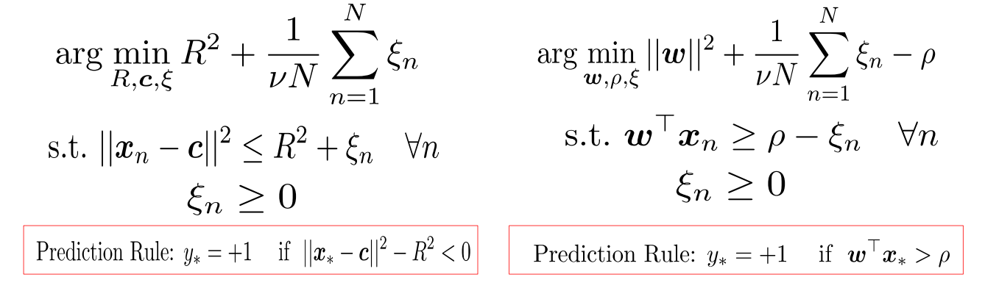
One-Class Classification via SVM-like methods
There are two popular SVM-type approaches to solve one-class problems
Support Vector Data Description (SVDD) One-Class SVM (OC-SVM)
Approach 1: Assume positives lie within a ball with smallest possible radius (and allow slacks)
Known as “Support Vector Data Description” (SVDD). Proposed by [Tax and Duin, 2004]
Approach 2: Find a max-marg hyperplane separating positives from origin (representing negatives)
Known as “One-Class SVM” (OC-SVM). Proposed by [Sch¨olkopf et al., 2001]
Optimization problems for both cases can be solved similary as in binary SVM (e.g., via Lagrangian)

Slide 39
References
These slides have been adapted from
Christoph F. EICK, Intro to Data Mining, University of Houston
David Sontag, DS-GA-1003: Machine Learning and Computational Statistics
Pyush Raj, CS 771A: Introduction to Machine Learning, IITK

